Slide 1
Python Web crawler 網路爬蟲
Pyt285123 何奇軒
Final Report

Slide 2
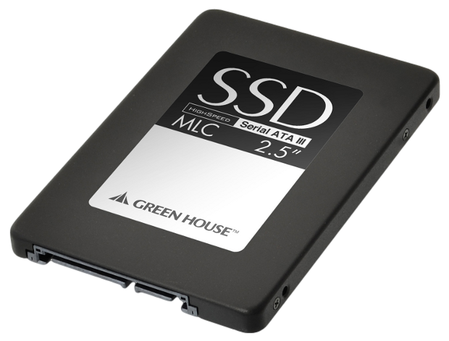
Outline
Structure
Packages
Requests
Json
Re
Application
Taobao.com
Further work

Slide 3


Structure
Website
HTML, JavaScript,… original code(Raw data)
Clean Data
Find useful information
Data Analysis

Slide 4
Packages
Requests
讀取http 網頁套件
Json
輕量級的數據交換格式套件
Re
格式化表達的模組套件

Slide 5
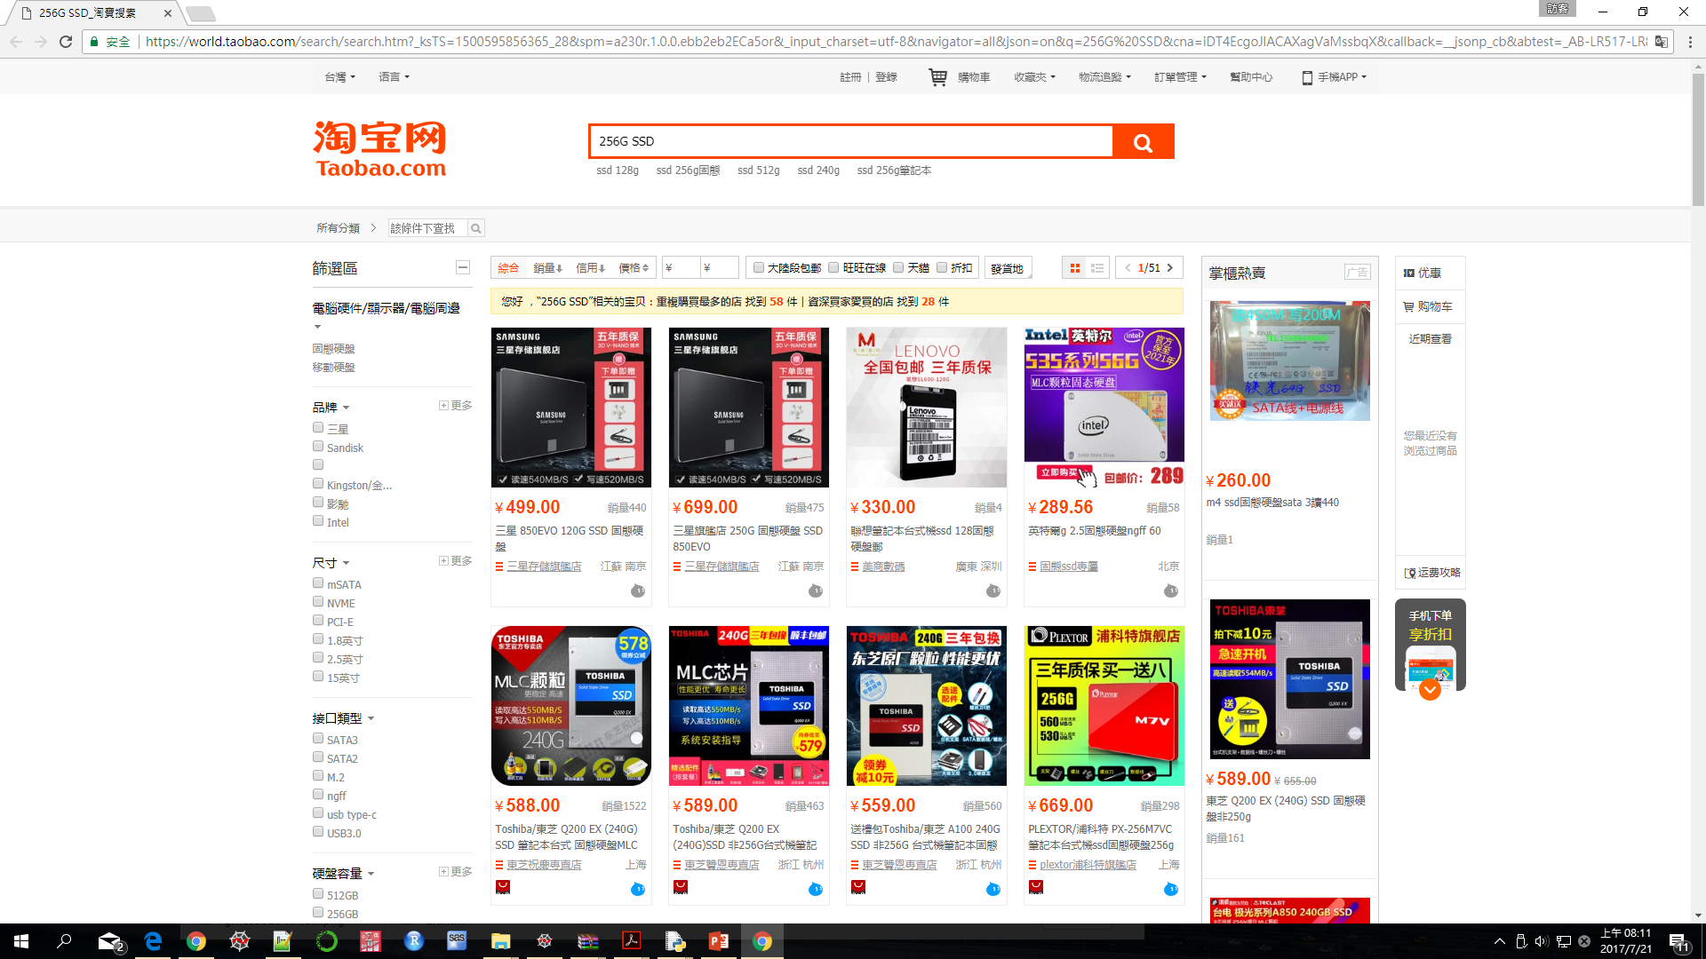
Application
Taobao.com

Slide 6
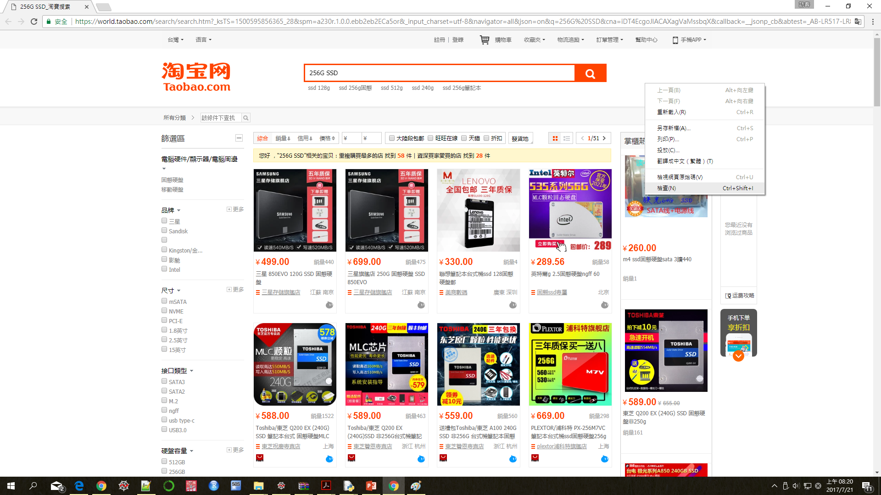
Application
Check the information of this website.

Slide 7
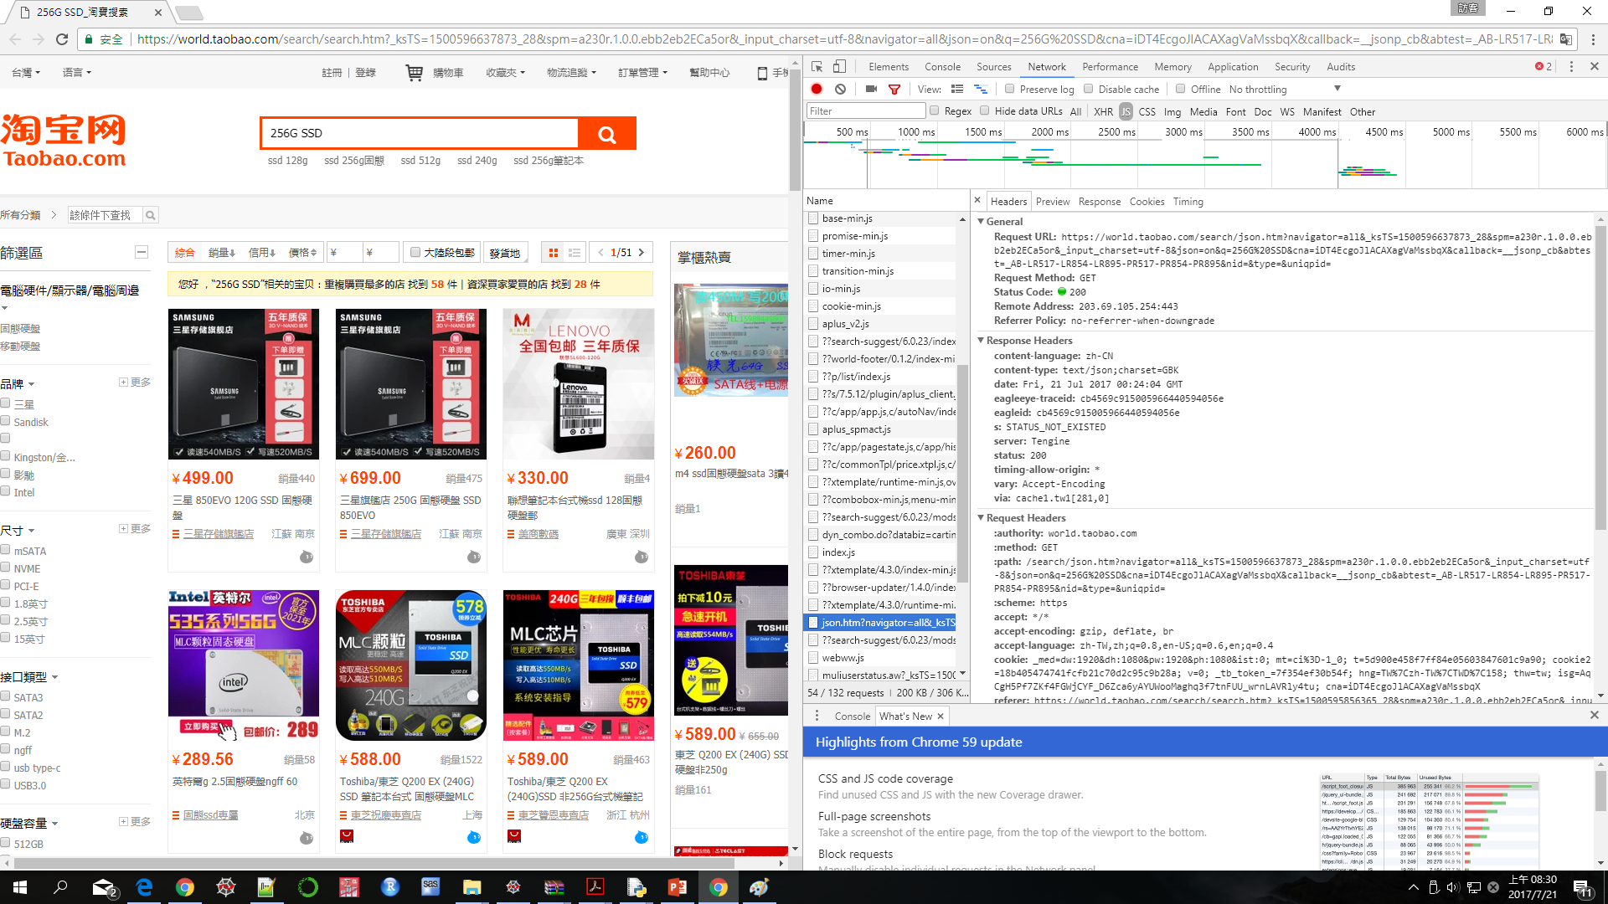
Application
Get the URL that we need.

Slide 8
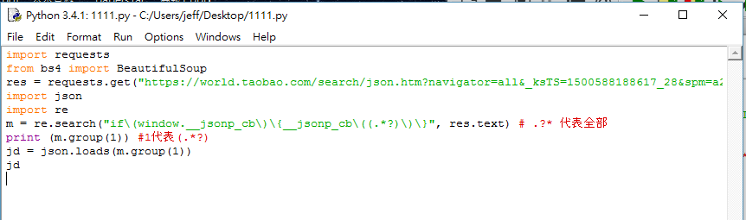
Application
Read the json file and use re to pick important message.(All)

Slide 9
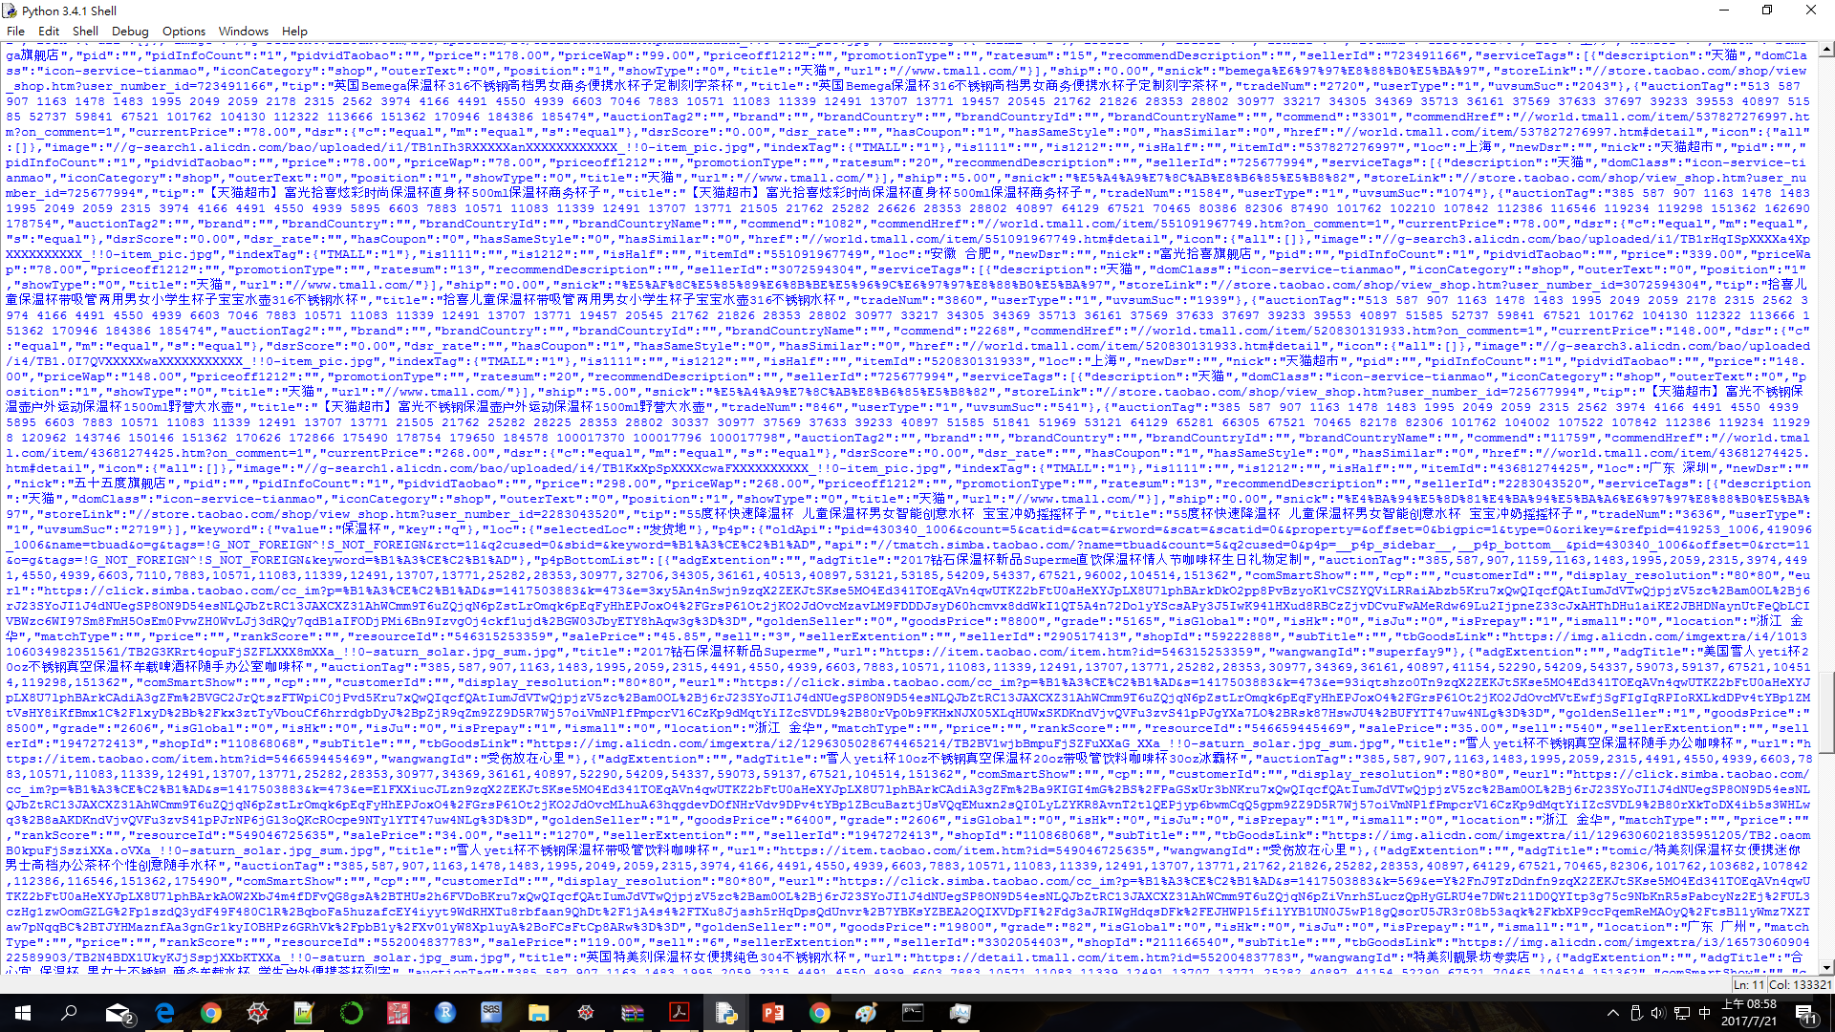
Application
Jd file

Slide 10
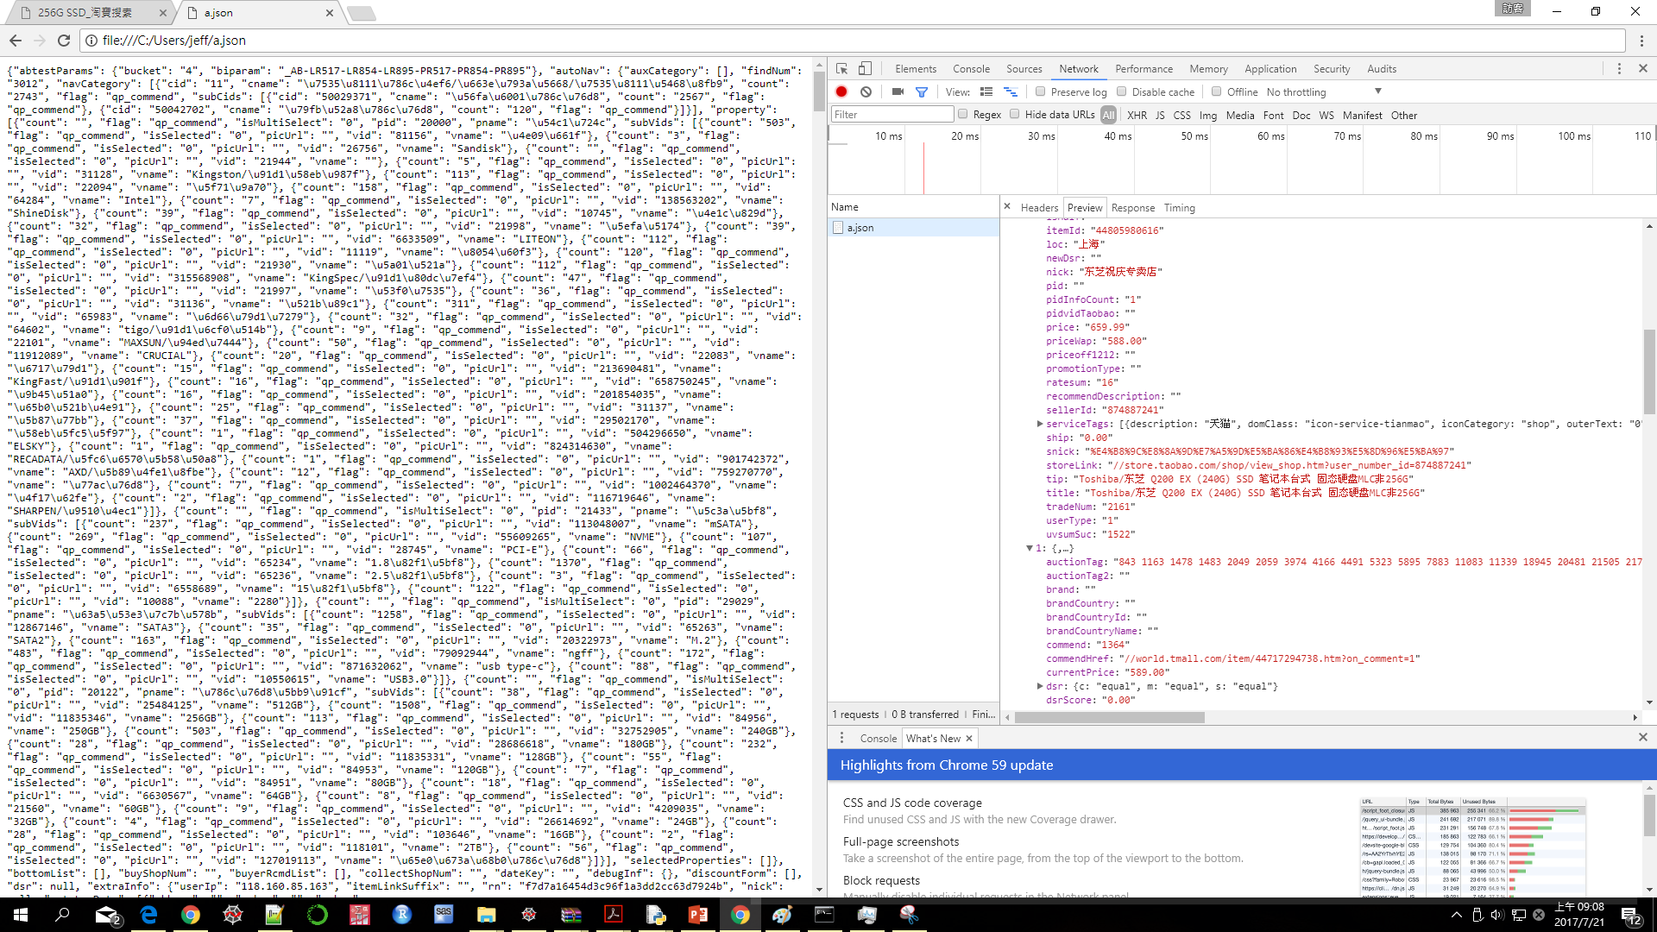
Application
Open the jd file with Chrome and find the information we need

Slide 11
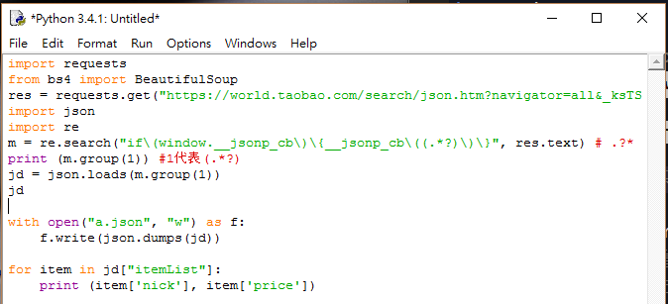
Application
Open the jd file with Chrome and find the information we need

Slide 12
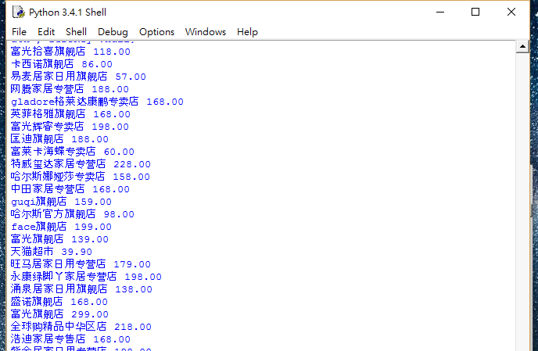
Application
Final Data

Slide 13
Further Work
Simple Data Analysis
e.g. seller ratings and product quality.
Sort the price of SSD.
The choice of the manufacturer.
Product reviews.
Further Data Analysis (ML)
The relationships among between manufacturer, product quality and product reviews.
Predict the future vision of the manufacturer in some field.

Slide 14
Thank You

